Slide 1

KOUSSAY ZAYANI / EDITORIAL ATELIER
2026
Koussay
Zayani
BRAND DESIGNER & CREATIVE DEVELOPER
Editorial Atelier
Dubai, UAE

Slide 2

KOUSSAY ZAYANI / EDITORIAL ATELIER
2026
01 / The idea
Clarity becomes visible.
A personal identity built from Koussay’s way of working: focused strategy, editorial restraint, digital precision, and a warmth that makes premium work feel human.

Slide 3
KOUSSAY ZAYANI / EDITORIAL ATELIER
2026
02 / Signature
The Aperture
Primary mark / light grounds
Reverse mark / dark grounds

Slide 4
KOUSSAY ZAYANI / EDITORIAL ATELIER
2026
03 / Color
Warm authority.
Ink
Deep honey
Warm ivory
Sandstone
#161512
#B87922
#F3EDE0
#A79D8C

Slide 5
KOUSSAY ZAYANI / EDITORIAL ATELIER
2026
04 / Typography
Type with purpose.
Bodoni Moda
Geist
The detail carries the idea.
Structured / precise / current

Slide 6
KOUSSAY ZAYANI / EDITORIAL ATELIER
2026
05 / Voice
A considered character.
Direct
Perceptive
Clear decisions. Clear words.
See the business beneath the brief.
Disciplined
Warm
Every detail earns its place.
Premium can still feel human.

Slide 7
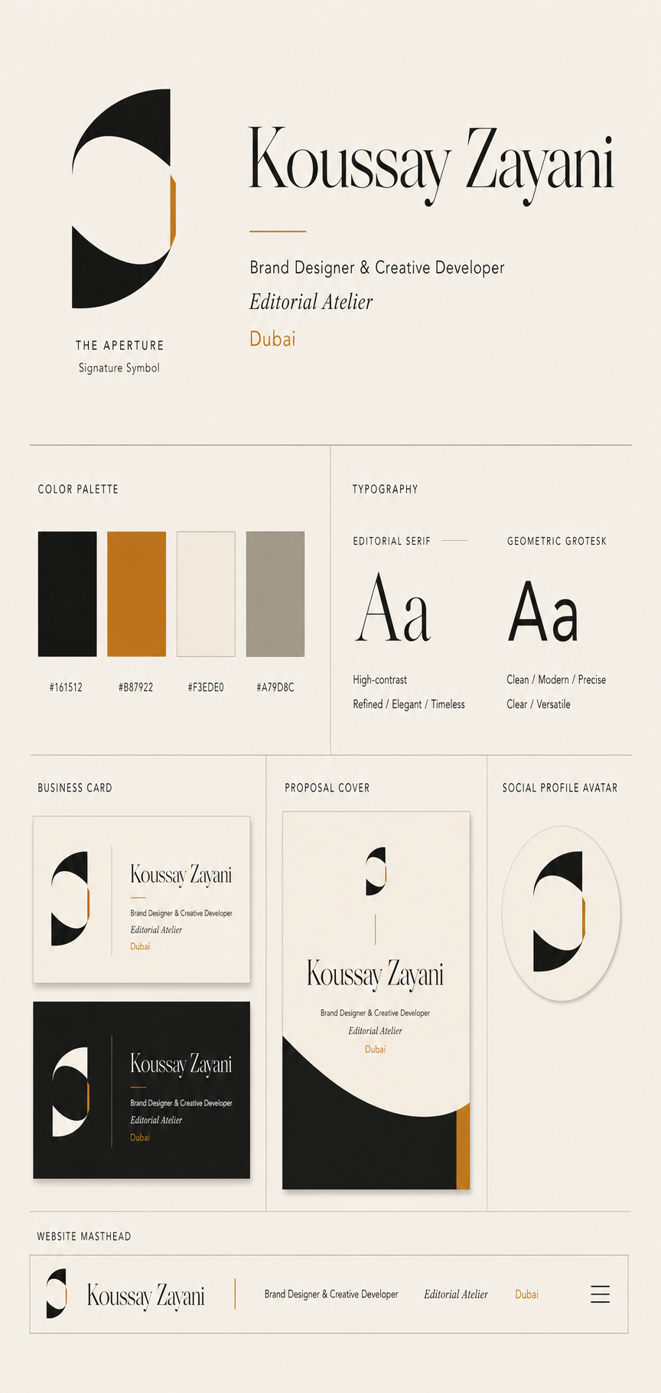
KOUSSAY ZAYANI / EDITORIAL ATELIER
2026
06 / Applications
Built for the real world.
The system has one visual voice across the work that matters: proposals, client-facing documents, social surfaces, project watermarks, and the portfolio itself.

Slide 8
KOUSSAY ZAYANI / EDITORIAL ATELIER
2026
Built to be remembered
before the meeting.
koussay.zayani0@gmail.com
Koussay Zayani / Editorial Atelier / Dubai

